Slide 1
Node workflow
Task orchestration in node.js
https://github.com/greuze/node-workflow-course
https://github.com/kusor/node-workflow

Slide 2
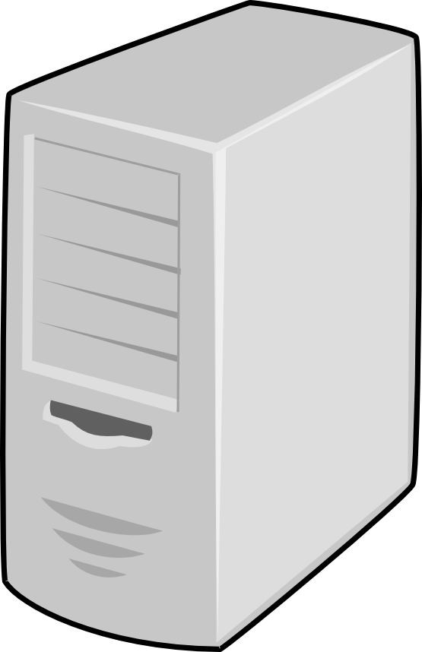


Sign up problem (sync)
API1
2
API2.2
1
3
5
6
12
4
8
11
7
API2
10
9
API4
API3

Slide 3
Sign up problem (sync)
API1
2
API2.2
1
3
5
6
8
4
7
API2
API4
API3

Slide 4
Sign up problem (async)
API1
2’
API2.2
1
3
5
6
2
4
8
11
7 (error)
API2
10
9
API4
API3

Slide 5
Sign up problem (async)
API1
2’
API2.2
1
3
5
6
2
4
7 (error)
API2
API4
API3

Slide 6
Sign up problem (workflow)
1
API1
4’
2’
API2.2
5’
2
3
8
5
9
6
4
2 = queued (0%)
5’ = running (40%)
9 = failed (70%)
7 (error)
API2
API4
API3

Slide 7
node-workflow app block diagram
App.js
A
P
I
Workflow-runner
Create_wf
Create_job
Factory
Backend

Slide 8
Flow diagram example
Sign up
Whole process
max. 10 minutes
User in backend
Error handling
Ok?
no
Error
Undo user in backend
Undo mail account
yes
no (4th time)
no
Mail account
Ok?
yes
External LDAP
Ok?
max. 2 minutes
yes
no (less than 3 retries)
Success

Slide 9
Workflow example
Whole process
max. 10 minutes
var workflow = {
name: 'sign up',
timeout: 600,
Sign up
User in backend
Error handling
no
Ok?
Error
Undo user in backend
Undo mail account
yes
no (4th time)
no
Mail account
Ok?
yes
External LDAP
Ok?
max. 2 minutes
yes
no (less than 3 retries)
Success

Slide 10
Workflow example
Whole process
max. 10 minutes
var workflow = {
name: 'sign up',
timeout: 600,
chain: [
{
name: 'user in backend',
body: function(job, cb) {
// Create user
(...)
Sign up
User in backend
Error handling
no
Ok?
Error
Undo user in backend
Undo mail account
yes
no (4th time)
no
Mail account
Ok?
yes
External LDAP
Ok?
max. 2 minutes
yes
no (less than 3 retries)
Success

Slide 11
Workflow example
Whole process
max. 10 minutes
var workflow = {
name: 'sign up',
timeout: 600,
chain: [
{
name: 'user in backend',
body: function(job, cb) {
// Create user
(...)
if (err) {
return cb(err);
} else {
return cb(null);
}
}
}
Sign up
User in backend
Error handling
no
Ok?
Error
Undo user in backend
Undo mail account
yes
no (4th time)
no
Mail account
Ok?
yes
External LDAP
Ok?
max. 2 minutes
yes
no (less than 3 retries)
Success

Slide 12
Workflow example
Whole process
max. 10 minutes
var workflow = {
name: 'sign up',
timeout: 600,
chain: [
{
name: 'user in backend',
body: function(job, cb) {
// Create user
(...)
if (err) {
return cb(err);
} else {
return cb(null);
}
}
},
{
name: 'mail account’,
retry: 3,
body: function(job, cb) {
// Create mail account
(...)
Sign up
User in backend
Error handling
no
Ok?
Error
Undo user in backend
Undo mail account
yes
no (4th time)
no
Mail account
Ok?
yes
External LDAP
Ok?
max. 2 minutes
yes
no (less than 3 retries)
Success

Slide 13
Workflow example
Whole process
max. 10 minutes
var workflow = {
name: 'sign up',
timeout: 600,
chain: [
{ name: 'user in backend', (...)},
{ name: 'mail account', retry: 3, (...)},
{ name: 'external ldap', timeout: 120, (...)}
],
onError [
Sign up
User in backend
Error handling
no
Ok?
Error
Undo user in backend
Undo mail account
yes
no (4th time)
no
Mail account
Ok?
yes
External LDAP
Ok?
max. 2 minutes
yes
no (less than 3 retries)
Success

Slide 14
Workflow example
Whole process
max. 10 minutes
var workflow = {
name: 'sign up',
timeout: 600,
chain: [
{ name: 'user in backend', (...)},
{ name: 'mail account', retry: 3, (...)},
{ name: 'external ldap', timeout: 120, (...)}
],
onError [
{
name: 'delete mail account',
retry: 3,
body: function(job, cb) { (...) },
},
{
name: 'delete mail account',
retry: 3,
body: function(job, cb) { (...) },
}
]
};
Sign up
User in backend
Error handling
no
Ok?
Error
Undo user in backend
Undo mail account
yes
no (4th time)
no
Mail account
Ok?
yes
External LDAP
Ok?
max. 2 minutes
yes
no (less than 3 retries)
Success

Slide 15
Workflow execution blocks
Task chain:
executed one by one if no error.
Fallback:
if exist, executed once when error
onError chain:
executed one by one

Slide 16
Workflow execution blocks
Task chain:
executed one by one if no error.
Fallback:
if exist, executed once when error
onError chain:
executed one by one
Task-1
Fallback-1
OnError-1
Task-2
Fallback-2
OnError-2
Task-3
Fallback-3
Task-4
Fallback-4
Execution succeded

Slide 17
Workflow execution blocks
Task chain:
executed one by one if no error.
Fallback:
if exist, executed once when error
onError chain:
executed one by one
Task-1
Fallback-1
OnError-1
Task-2
Fallback-2
OnError-2
Task-3
Fallback-3
Task-4
Fallback-4
Execution succeded

Slide 18
Workflow execution blocks
Task chain:
executed one by one if no error.
Fallback:
if exist, executed once when error
onError chain:
executed one by one
Task-1
Fallback-1
OnError-1
Task-2
Fallback-2
OnError-2
Task-3
Fallback-3
Task-4
Fallback-4
Execution failed

Slide 19

Examples
Yes, sure
Show me something working

Slide 20
Common problems & pitfalls
Debug within a workflow
New dependencies in workflows
Sensitive data stored in backend
Only one workflow with same name
Injected arrays:
opts instanceof Array -> false
Array.isArray(opts) -> true

Slide 21

Questions

Slide 22
Proposed exercises
Try do run the examples
Modify example-2 to force an error and see what happens
Modify example-2 to add more steps
Try some concurrent requests

